Slide 1
who gets the bonus?
Fichier créé le : 7/22/2021 10:45:07 AM

Slide 2
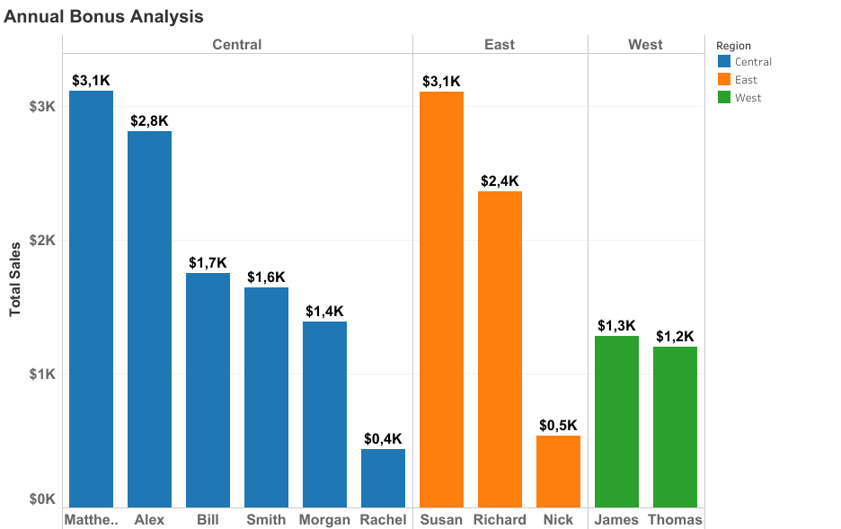

Slide 3
Synthesis
Sellers who will get bonus are :
Matthew in the Central region with $3,1k sales ;
Susan in the East region with $3,1k sales ;
James in the West region with $1,3k sales;

